Slide 1
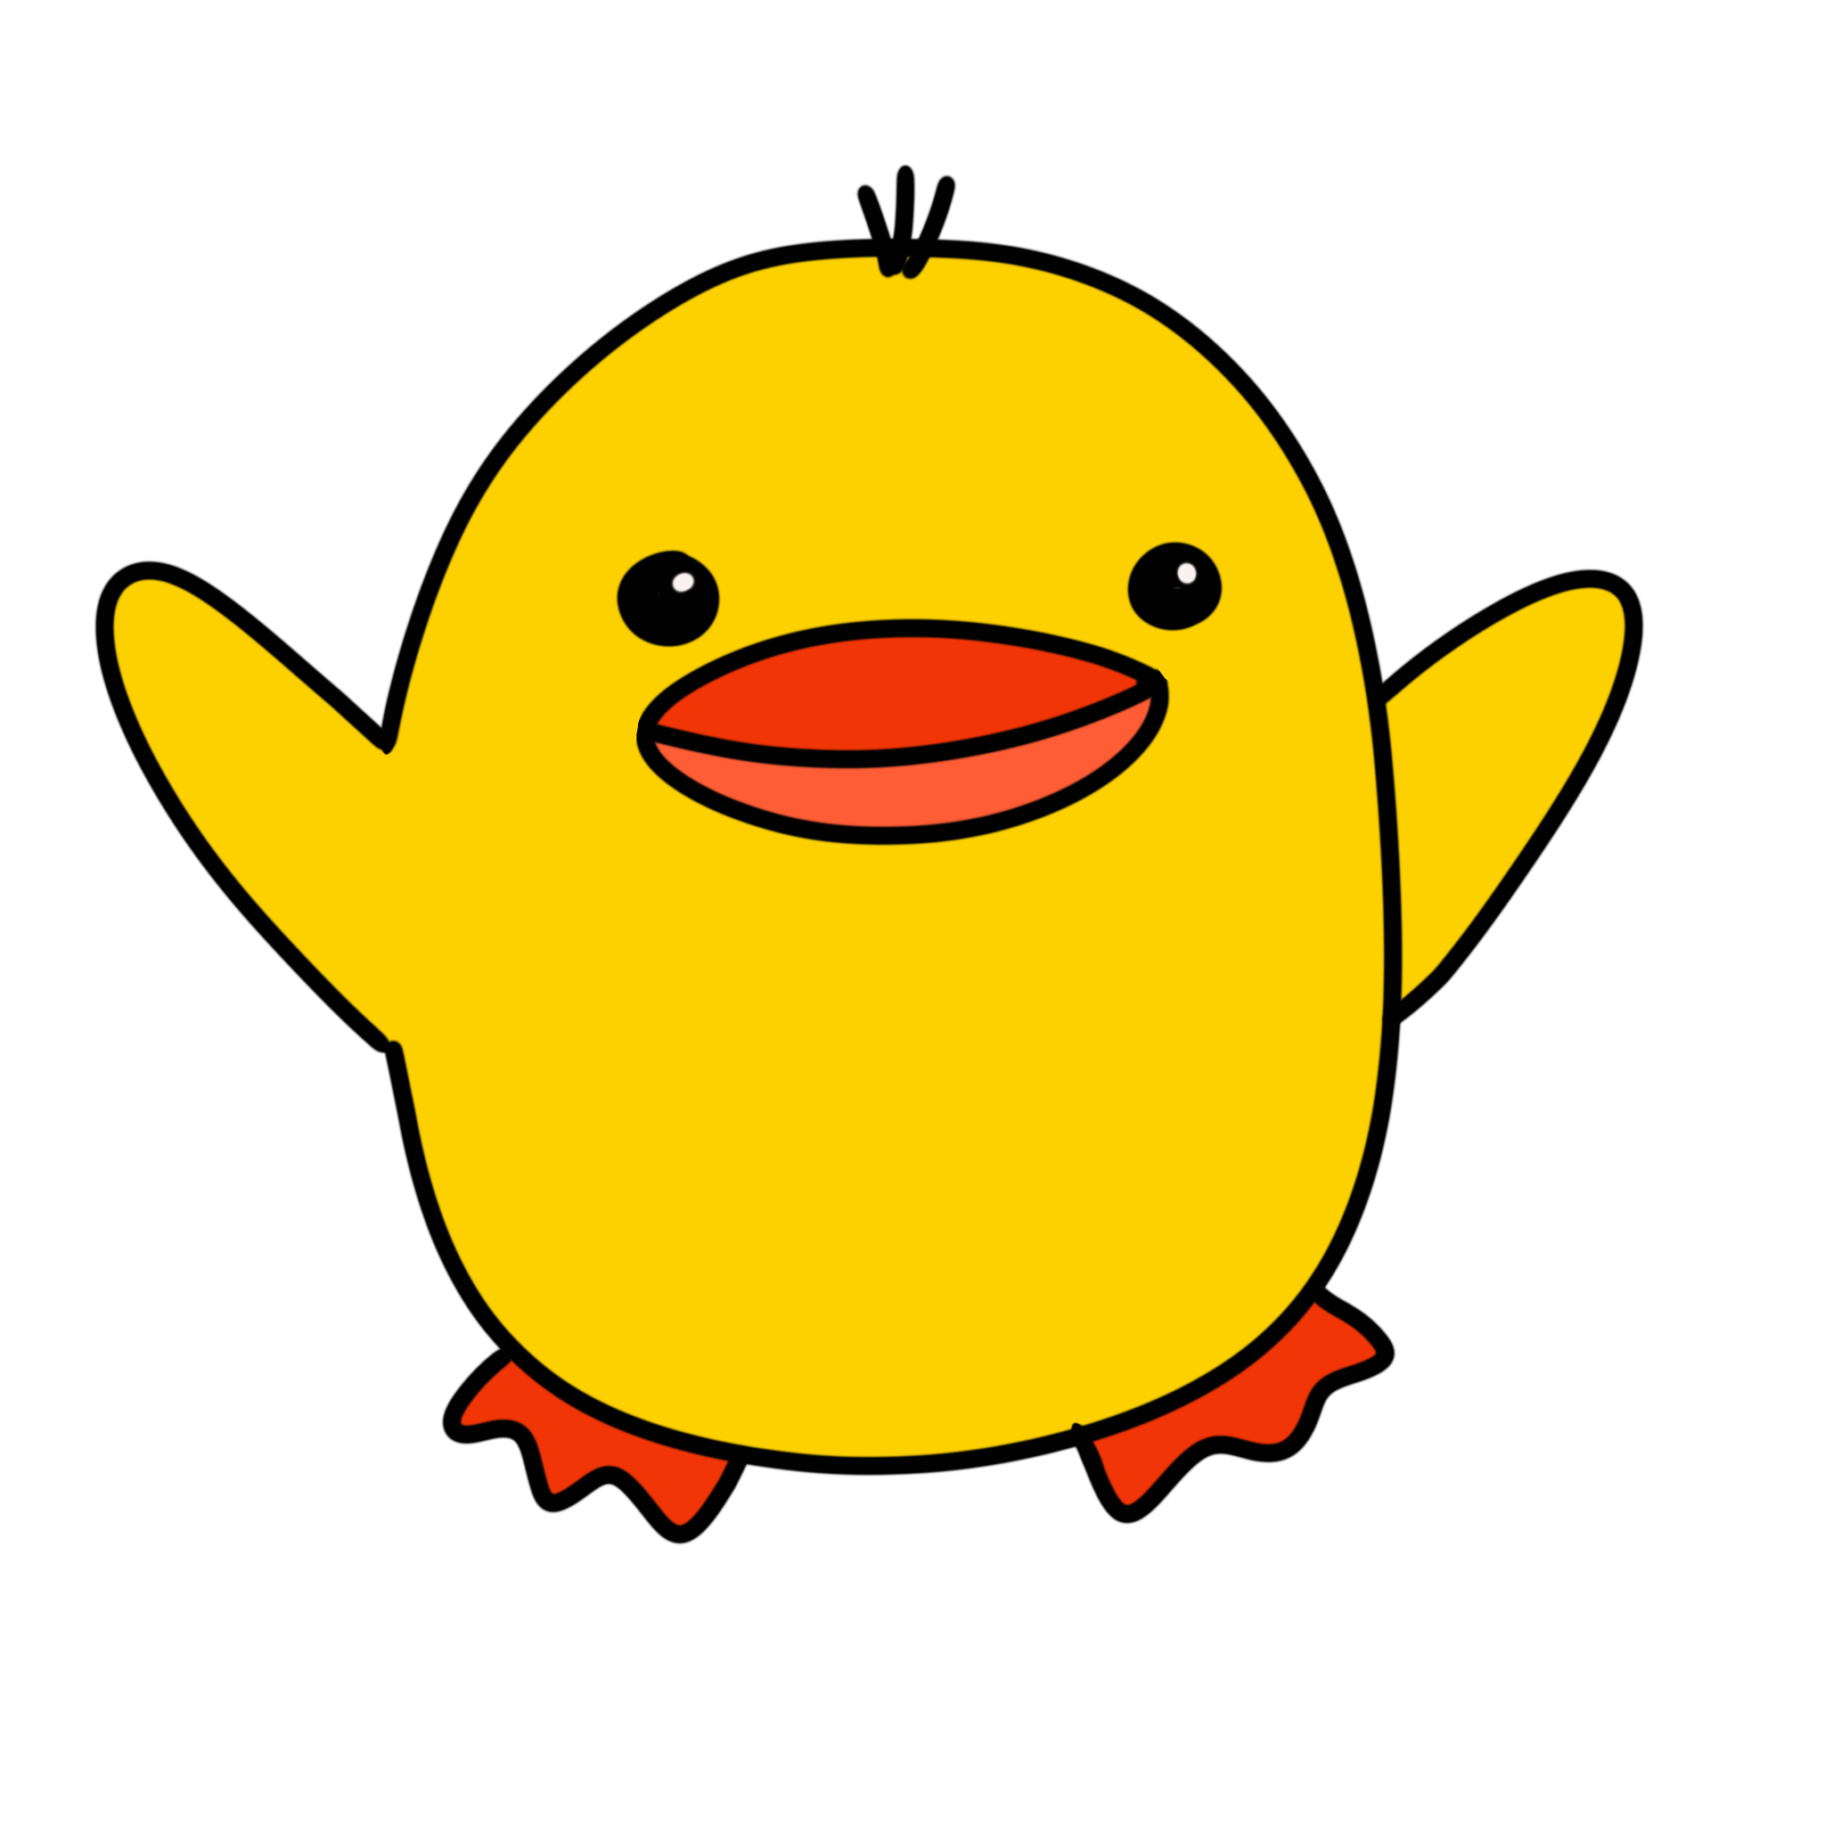

Team little duck
It’s just me. I’m the little duck.

Slide 2
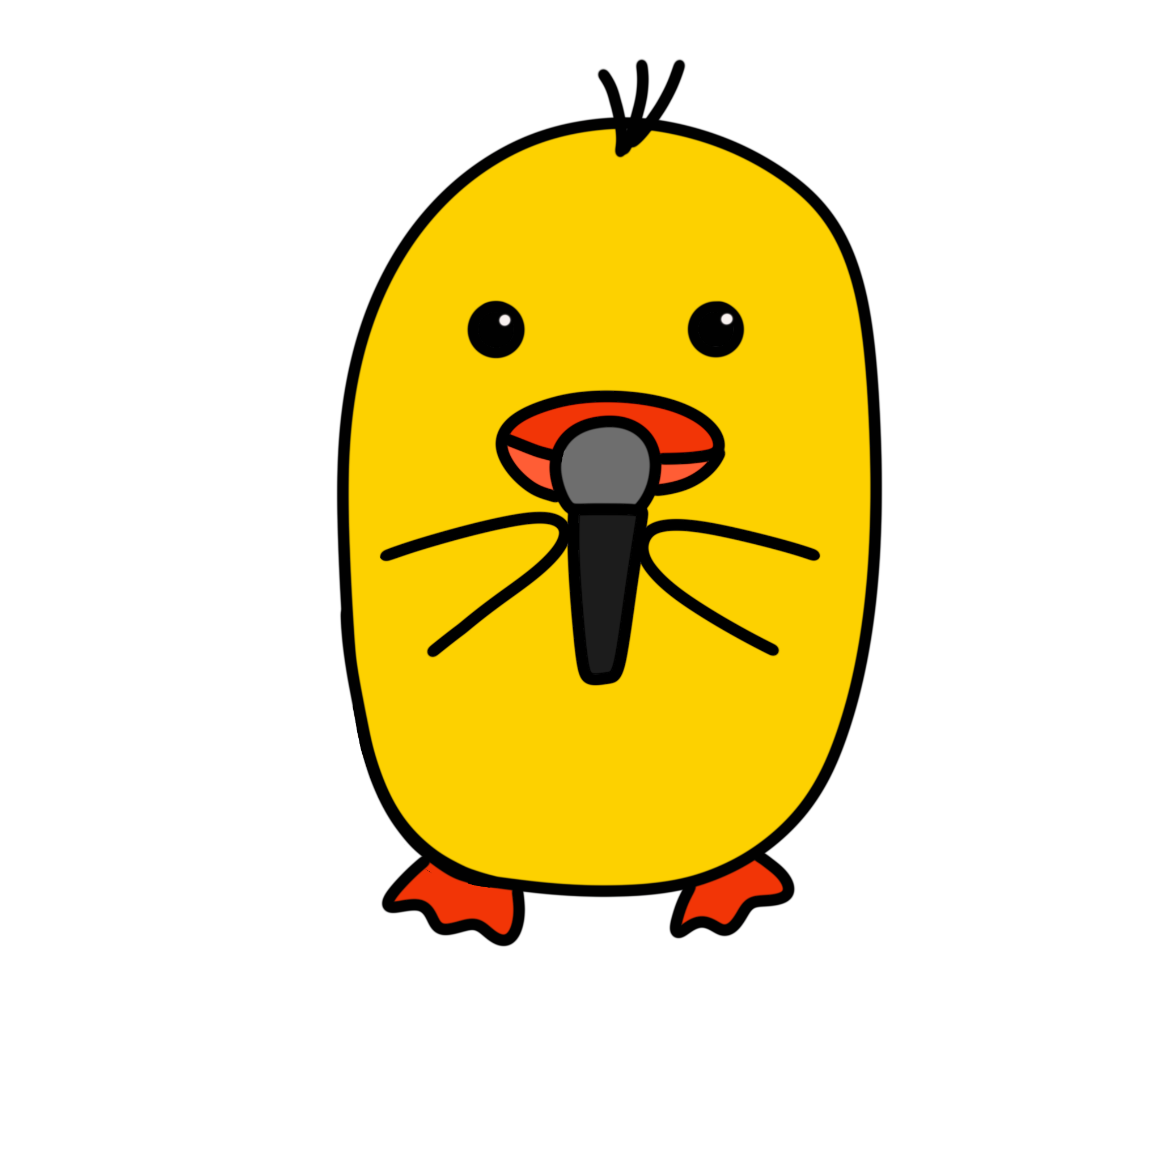
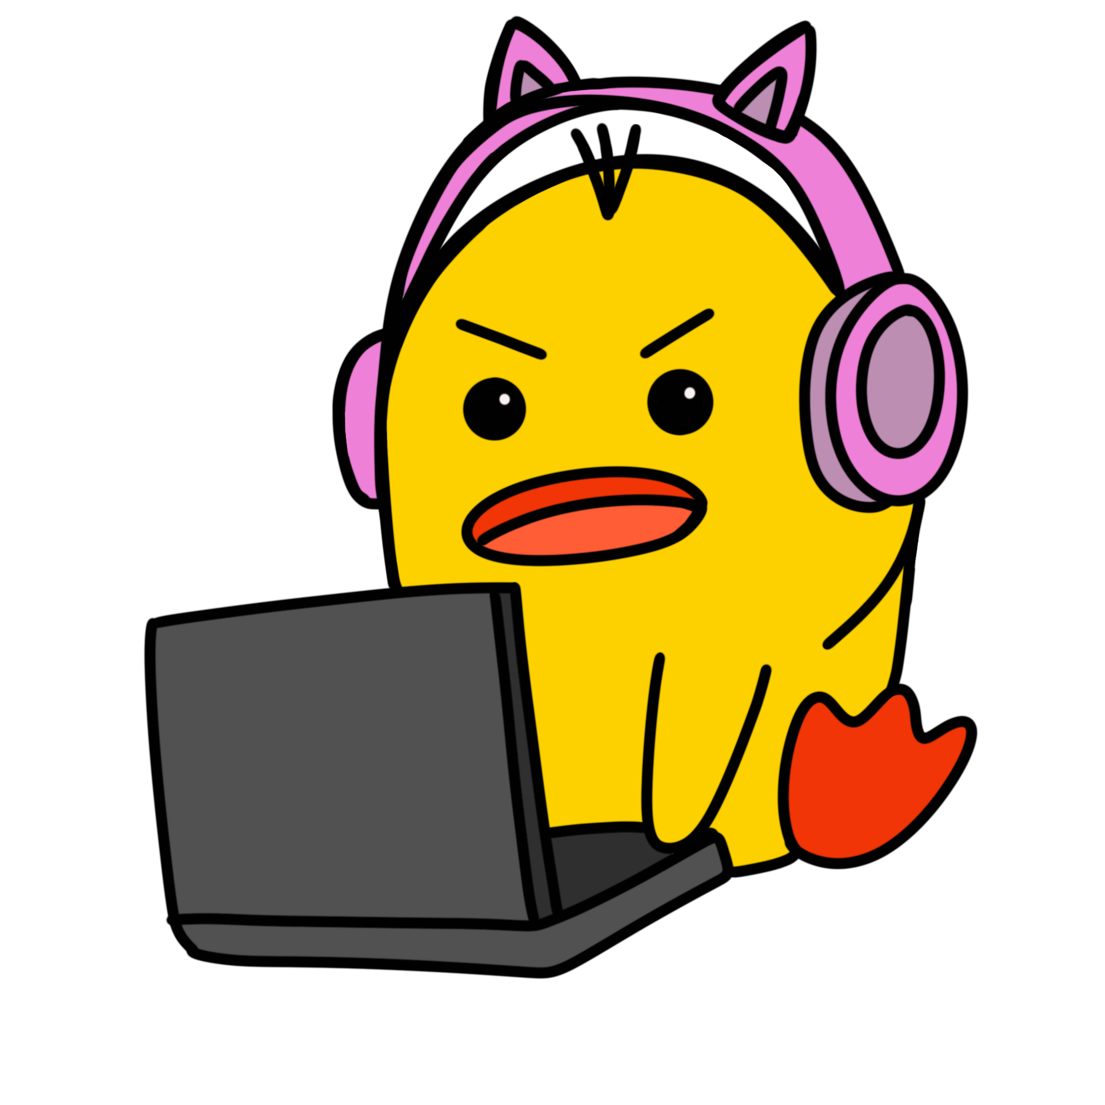
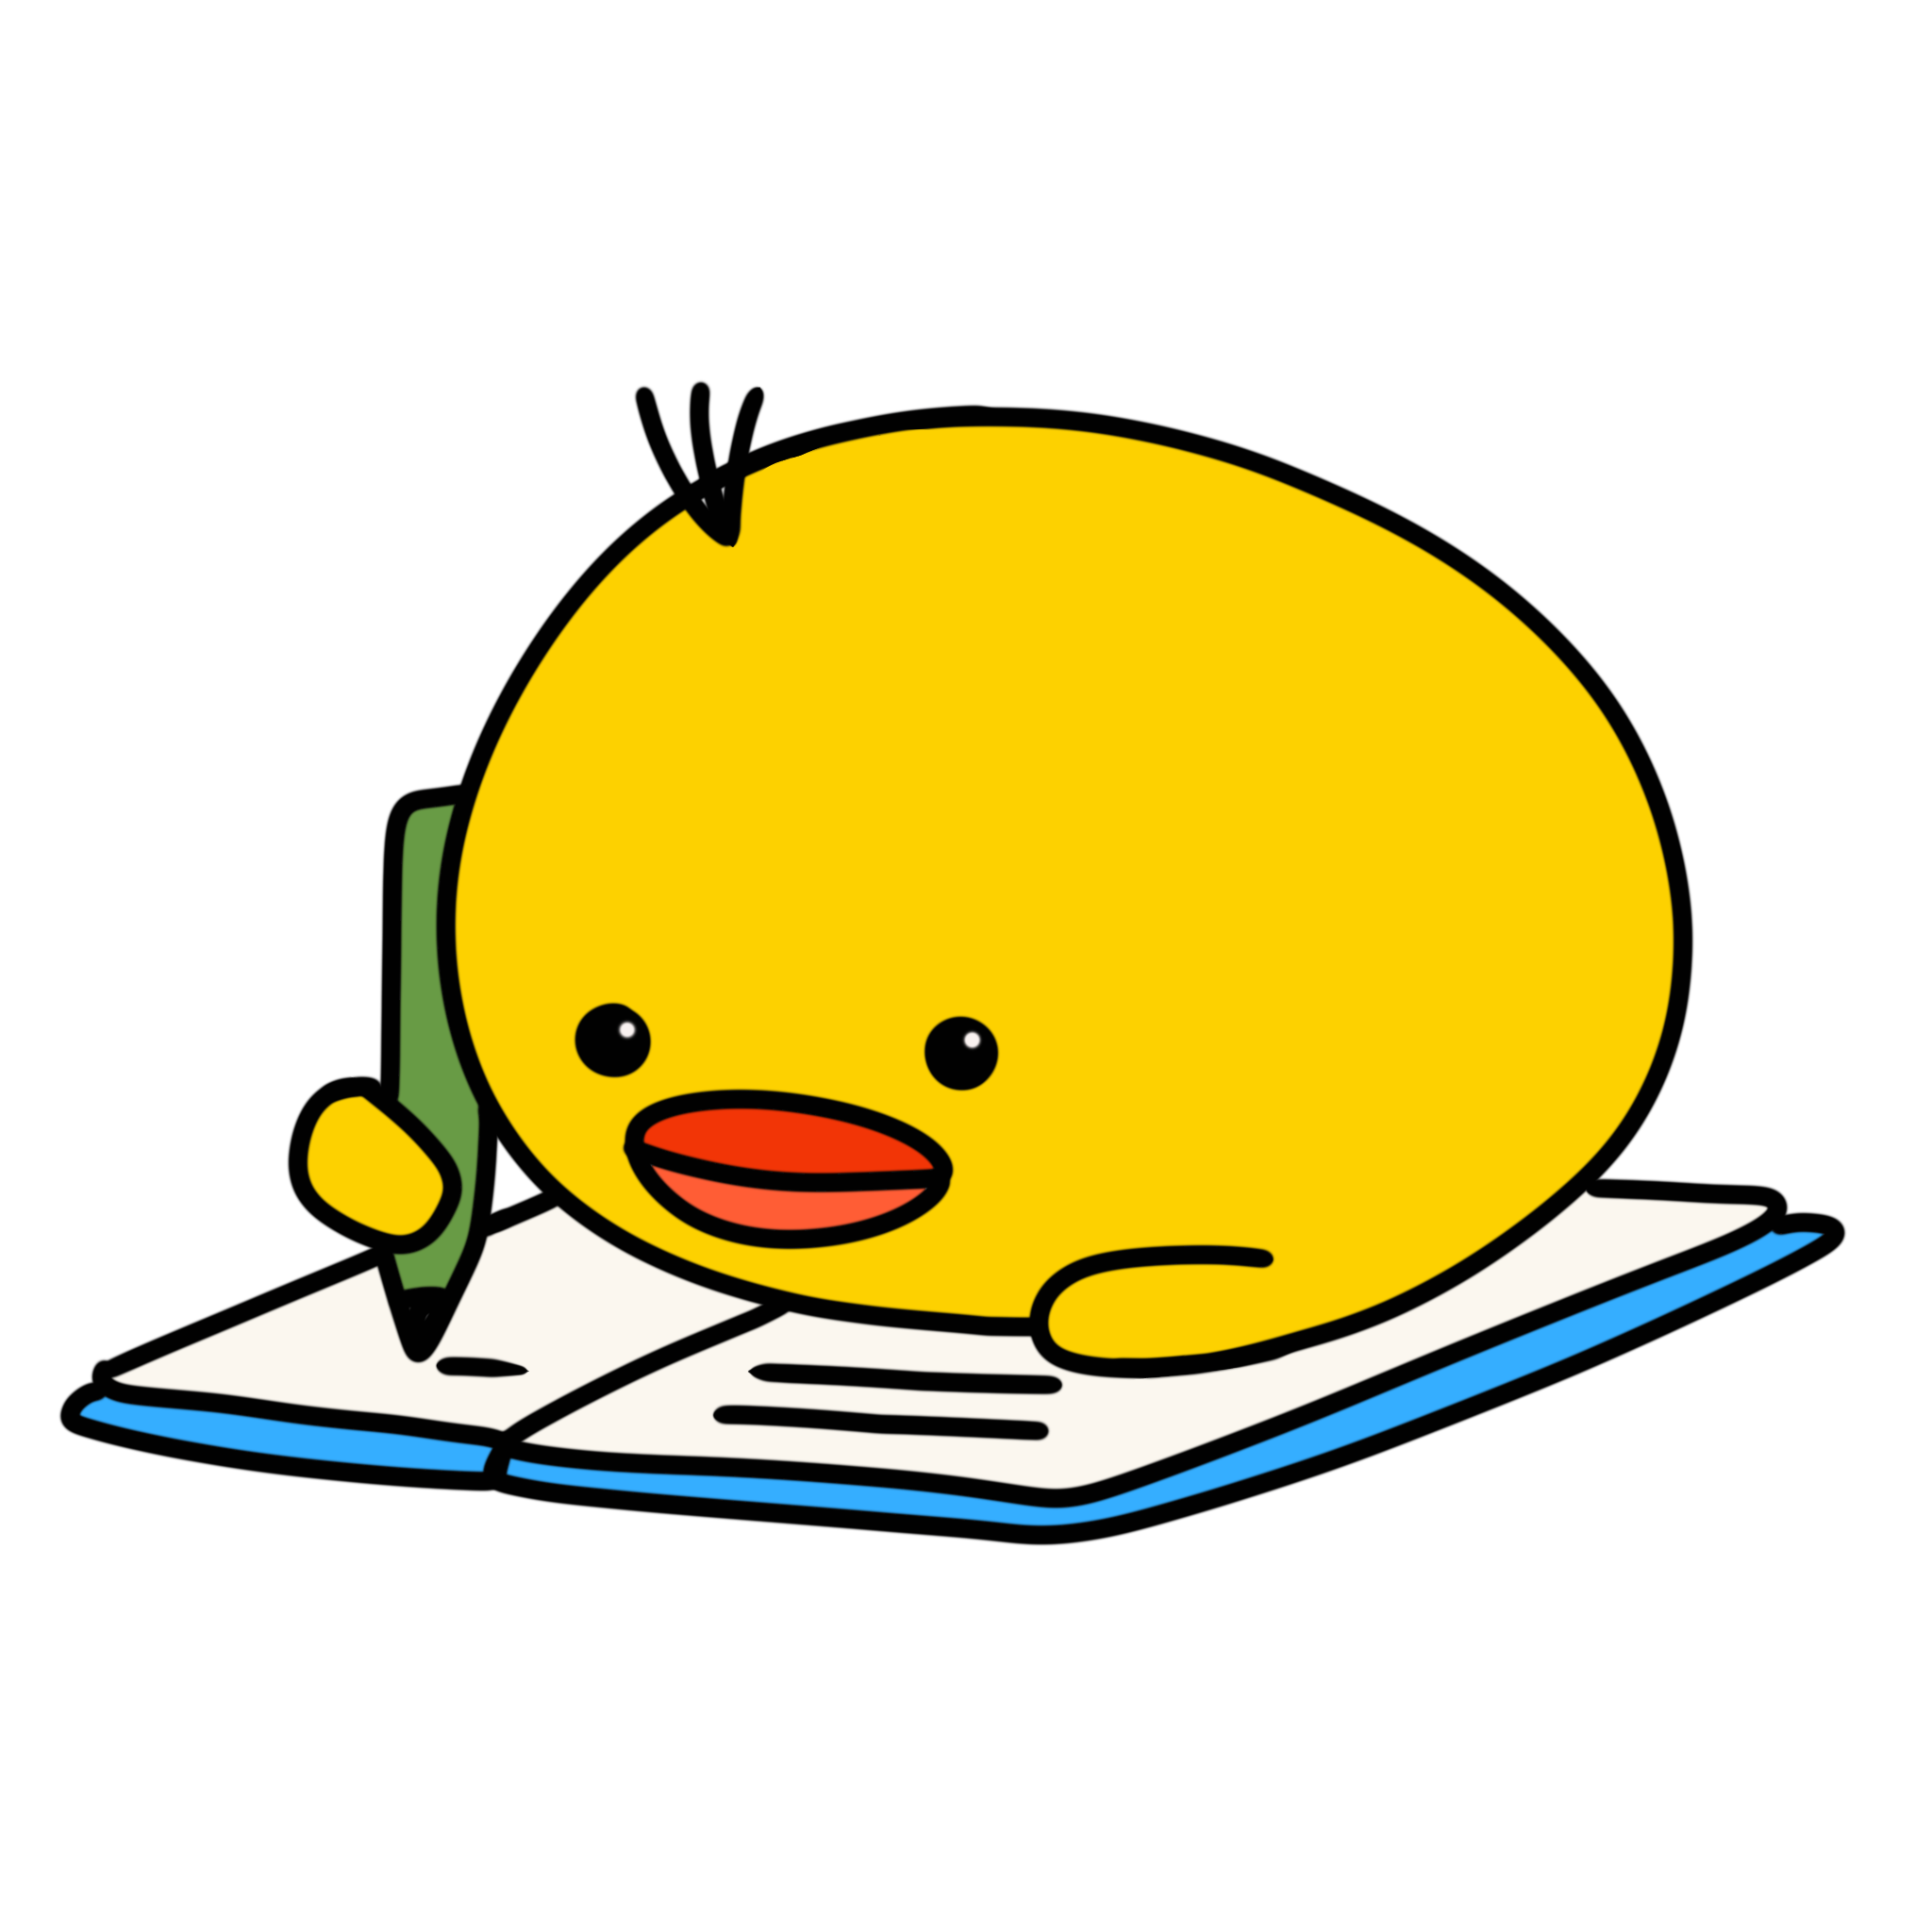
What did I do?
I RECORDED MYSELF READING IT
I MADE IT INTO AN AUDIOBOOK
I WROTE A SHORT STORY

Slide 3

The Challenges

Slide 4
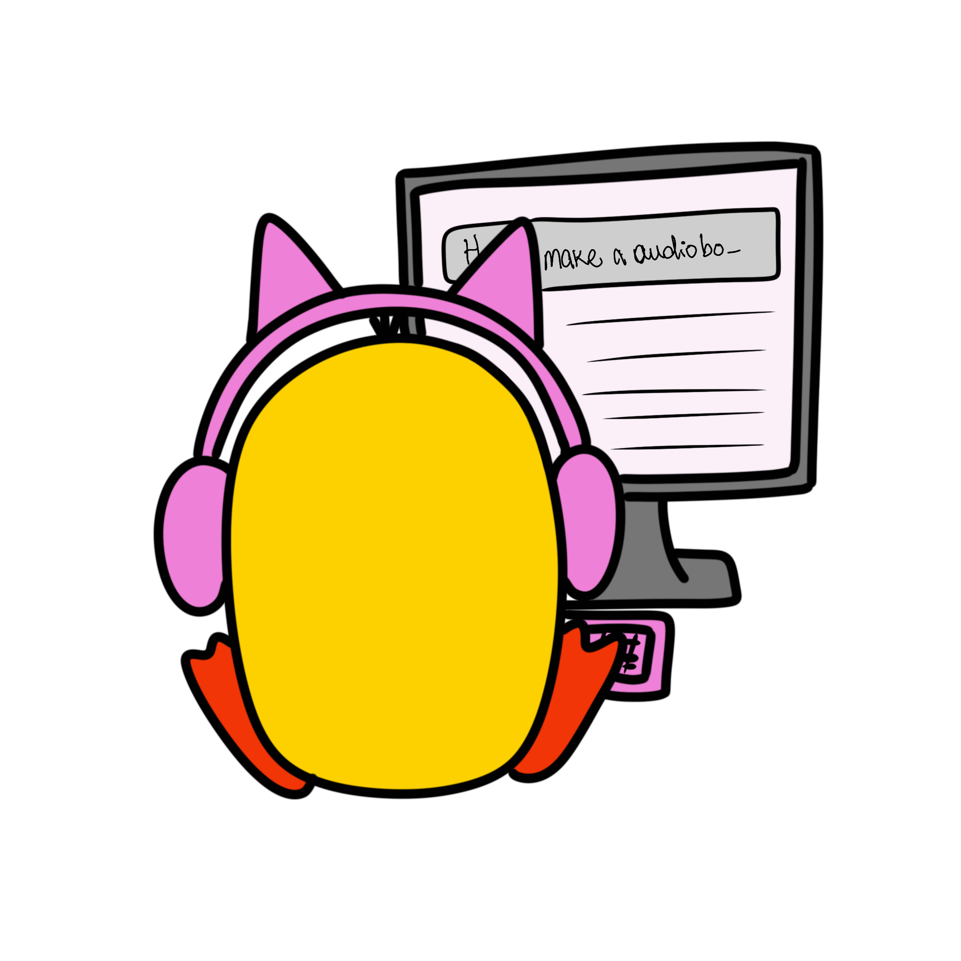
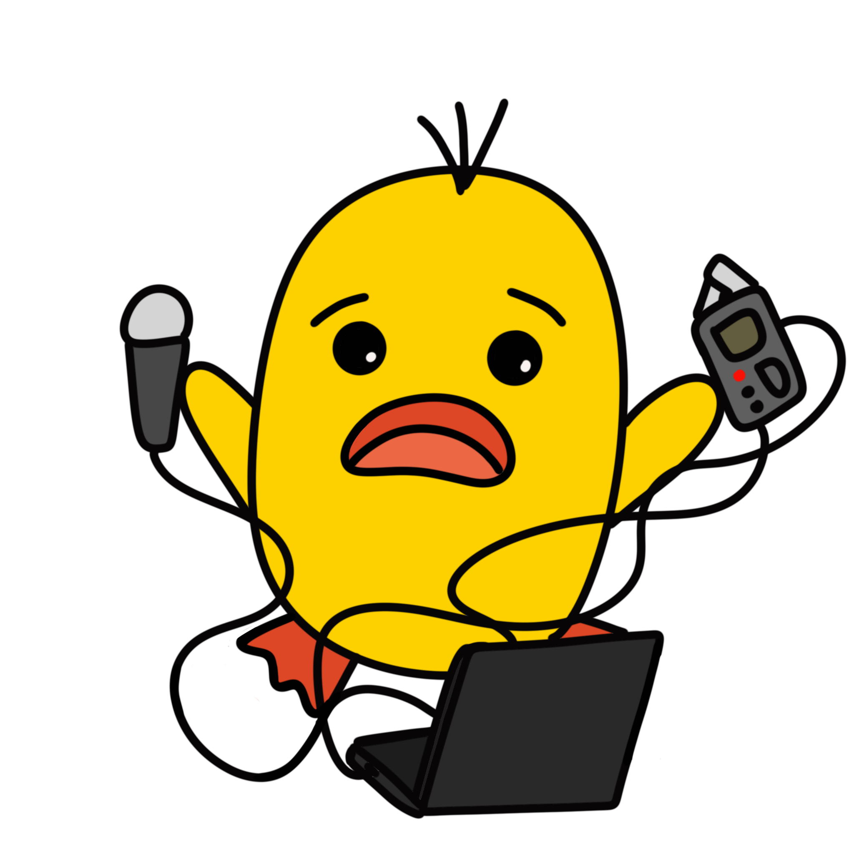
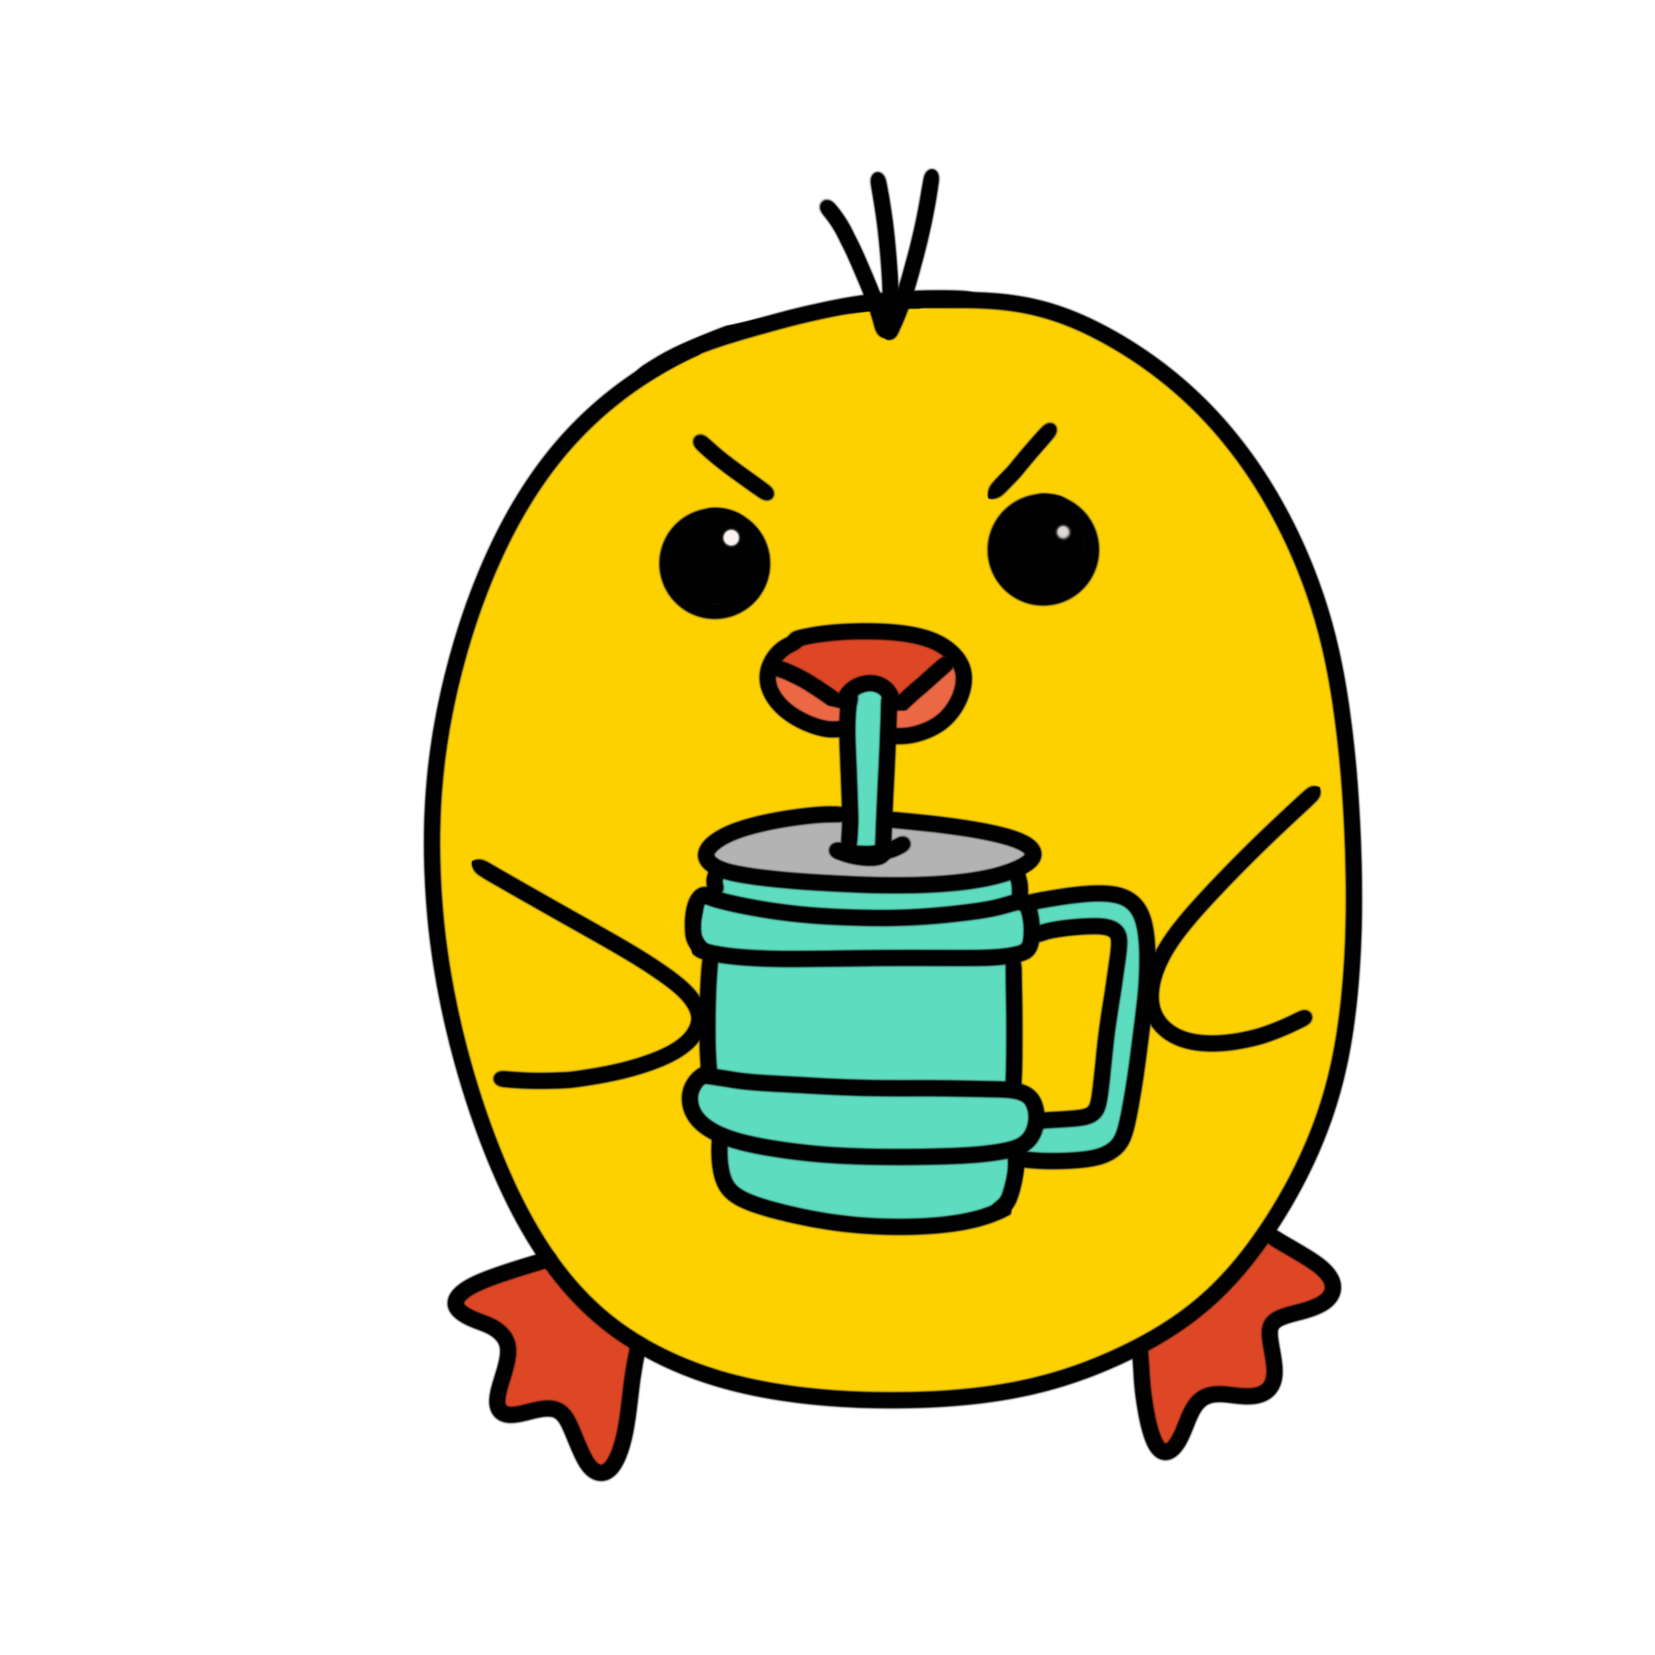
Finding the right story
Finding the right software
Computer settings
Microphone distance
Unfamiliar tech
Gross mouth noises
Trial and error and trial and error and trial and error and Google searches

Slide 5

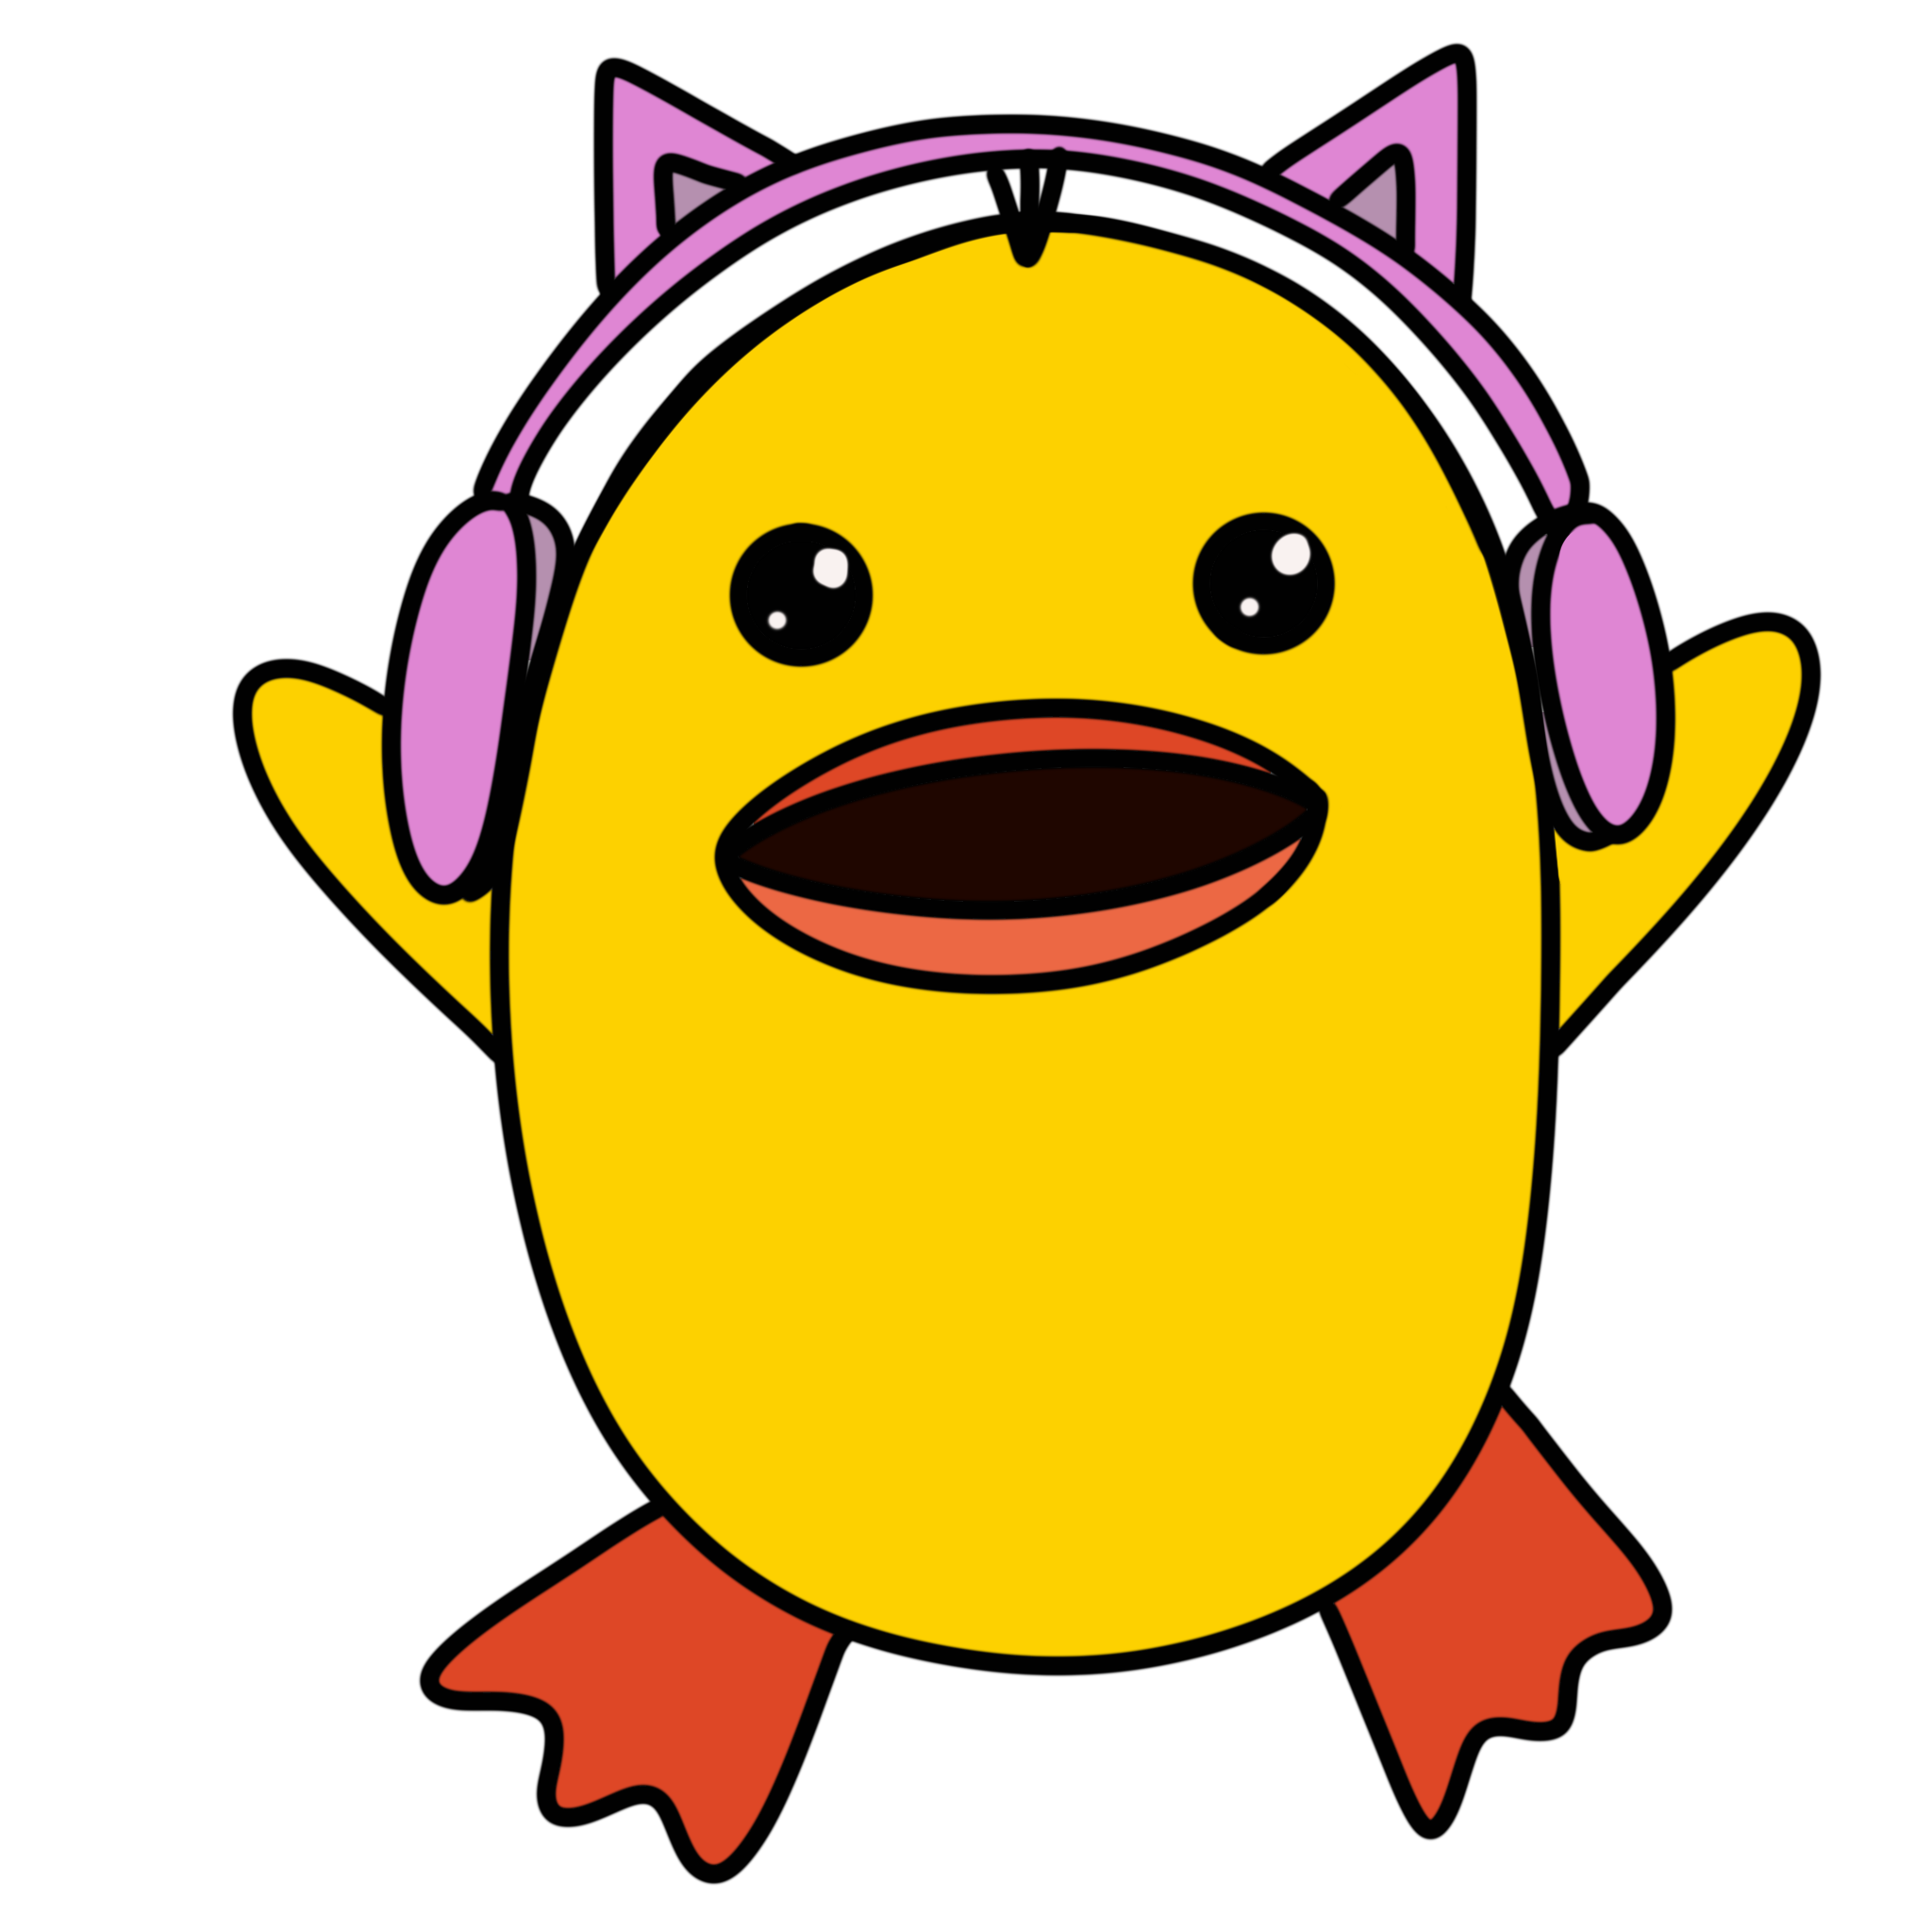
SOUND EFFECTS!
Editing the audio and adding…
They make everything better.

Slide 6
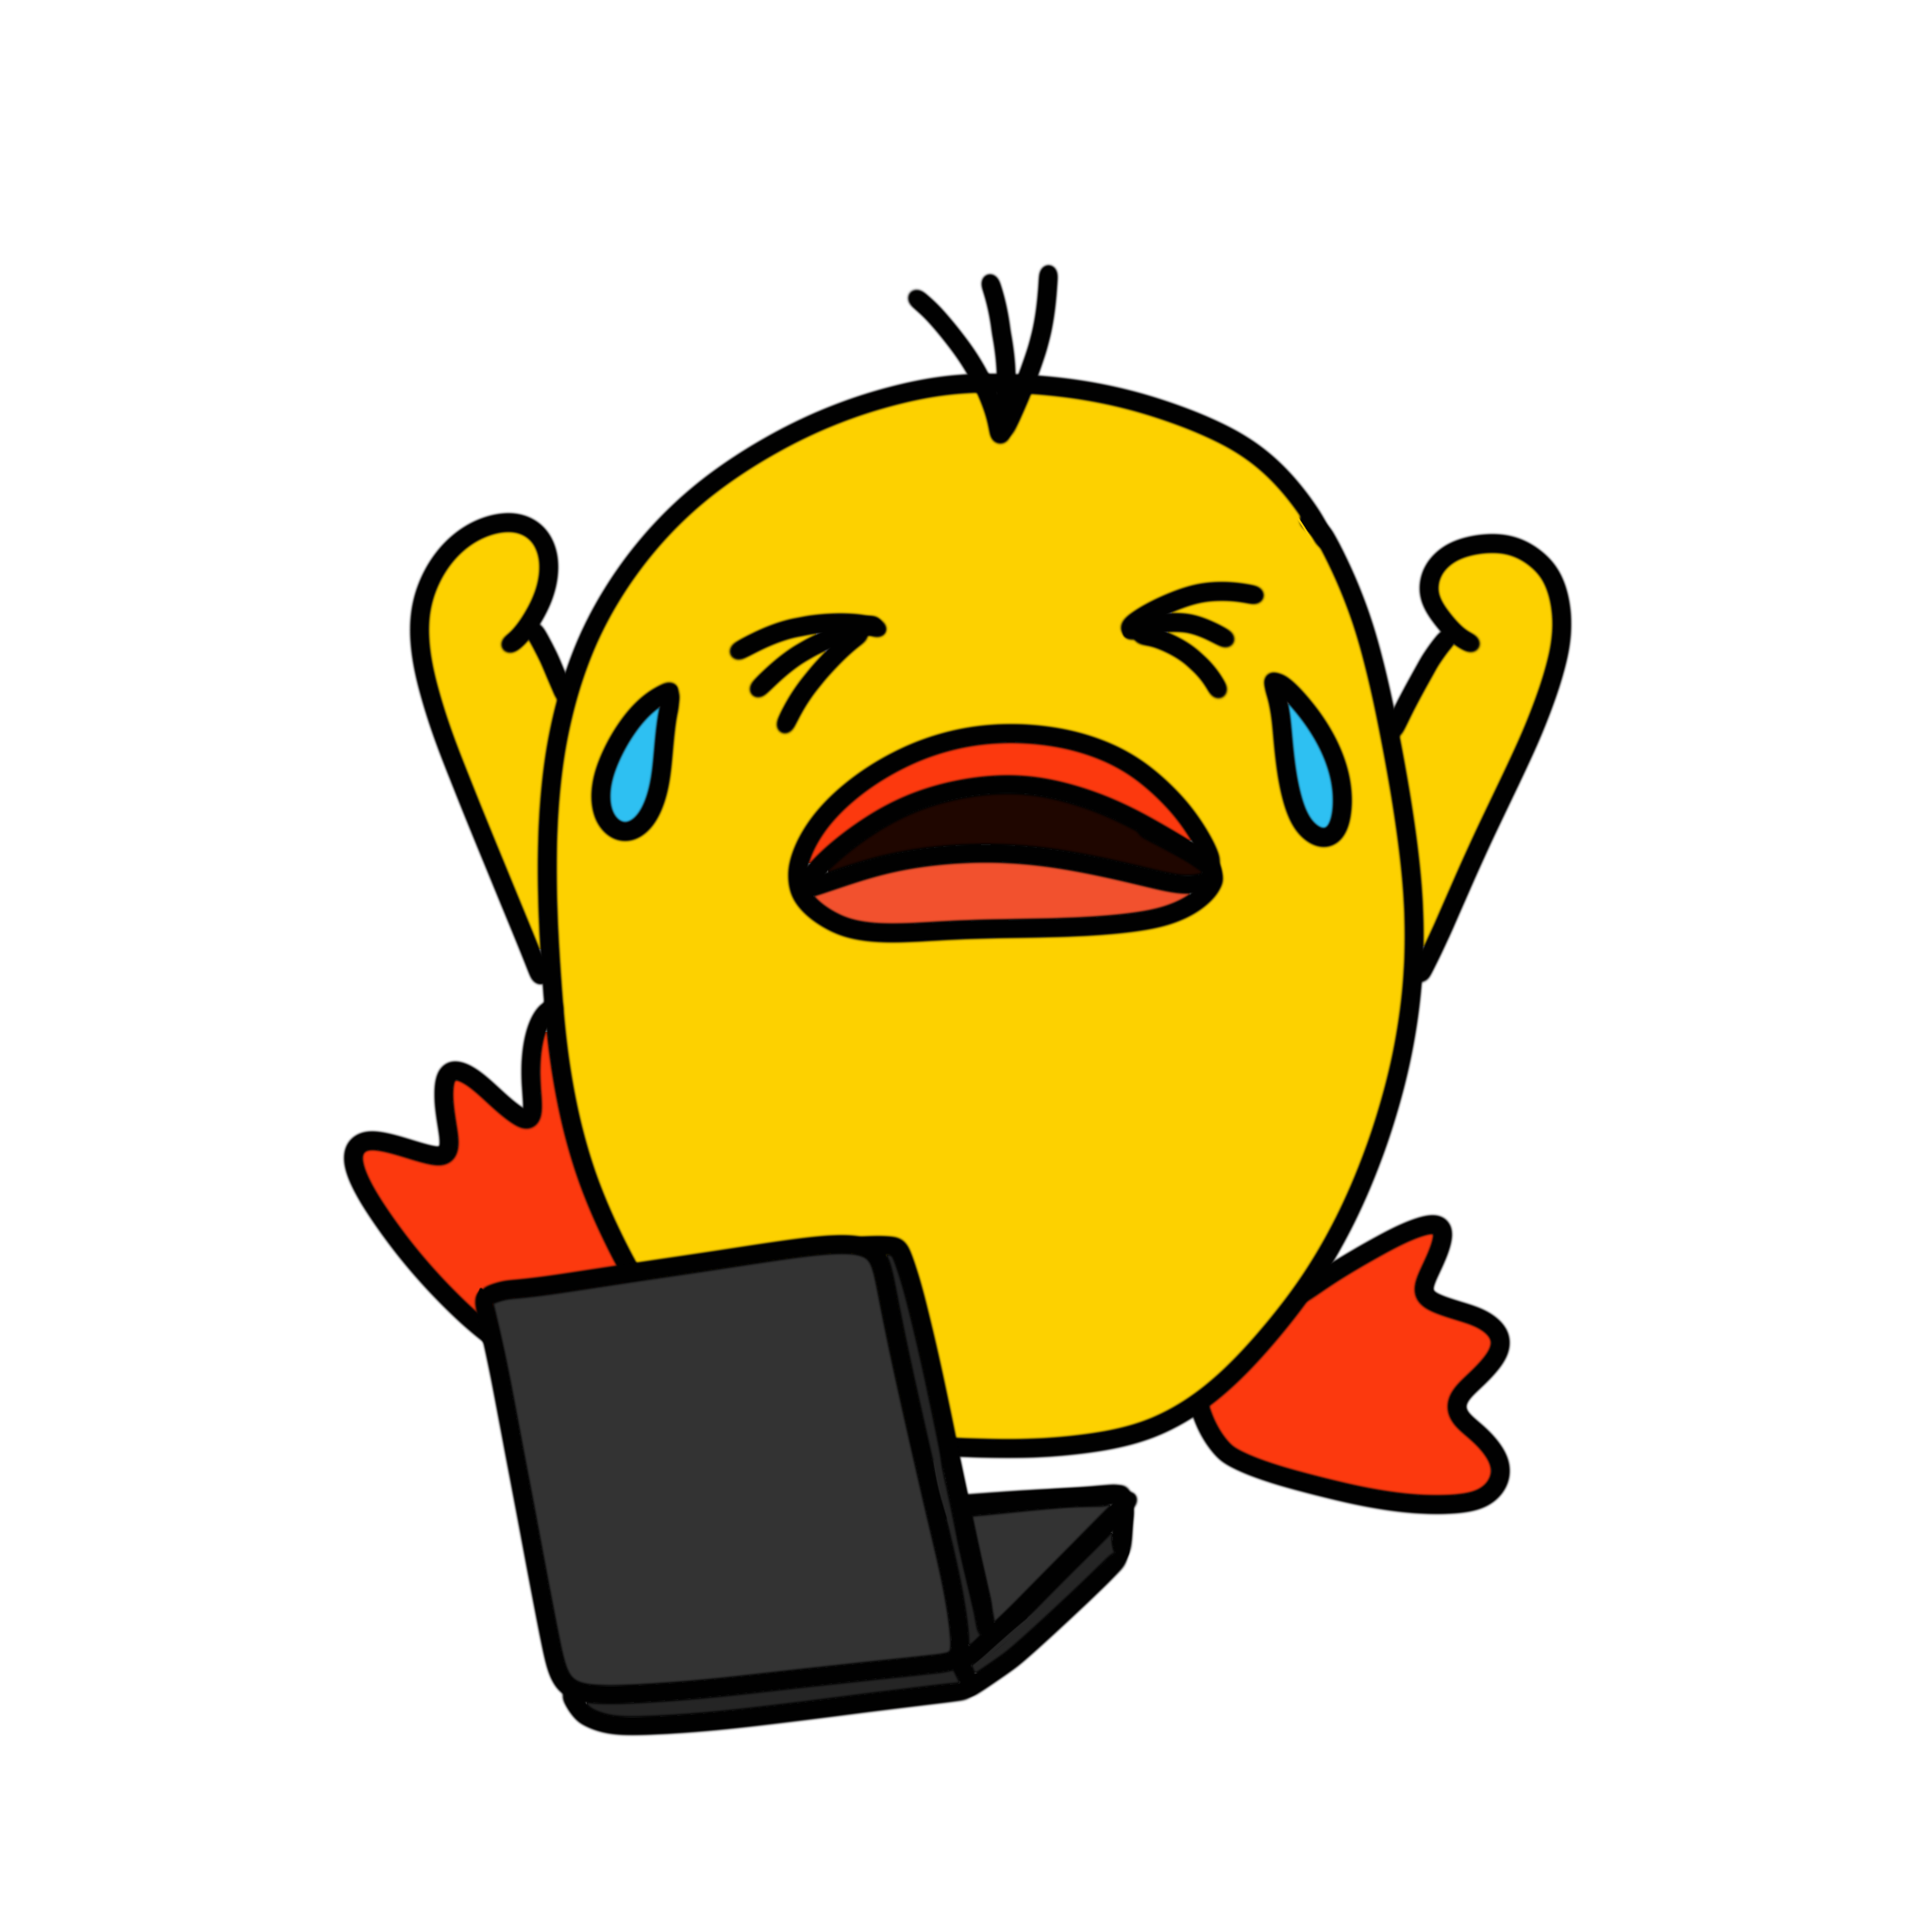
More dumb computer junk

Slide 7
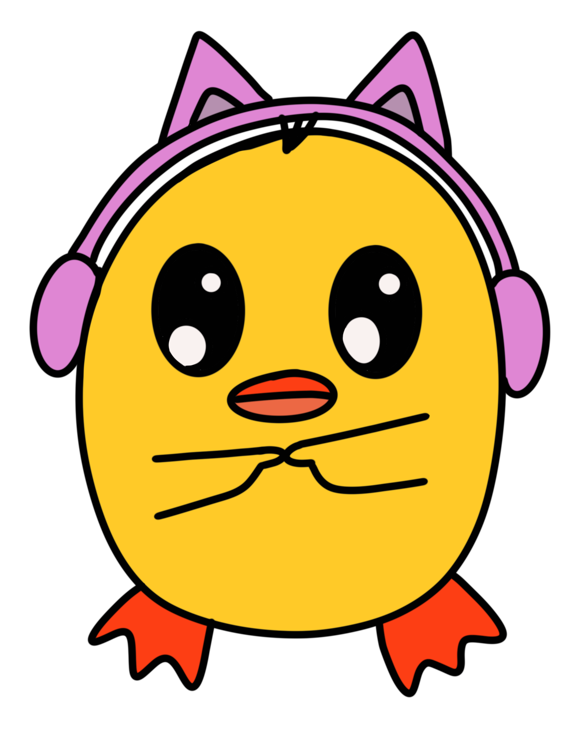
So……
Why don’t we check it out?

Slide 8
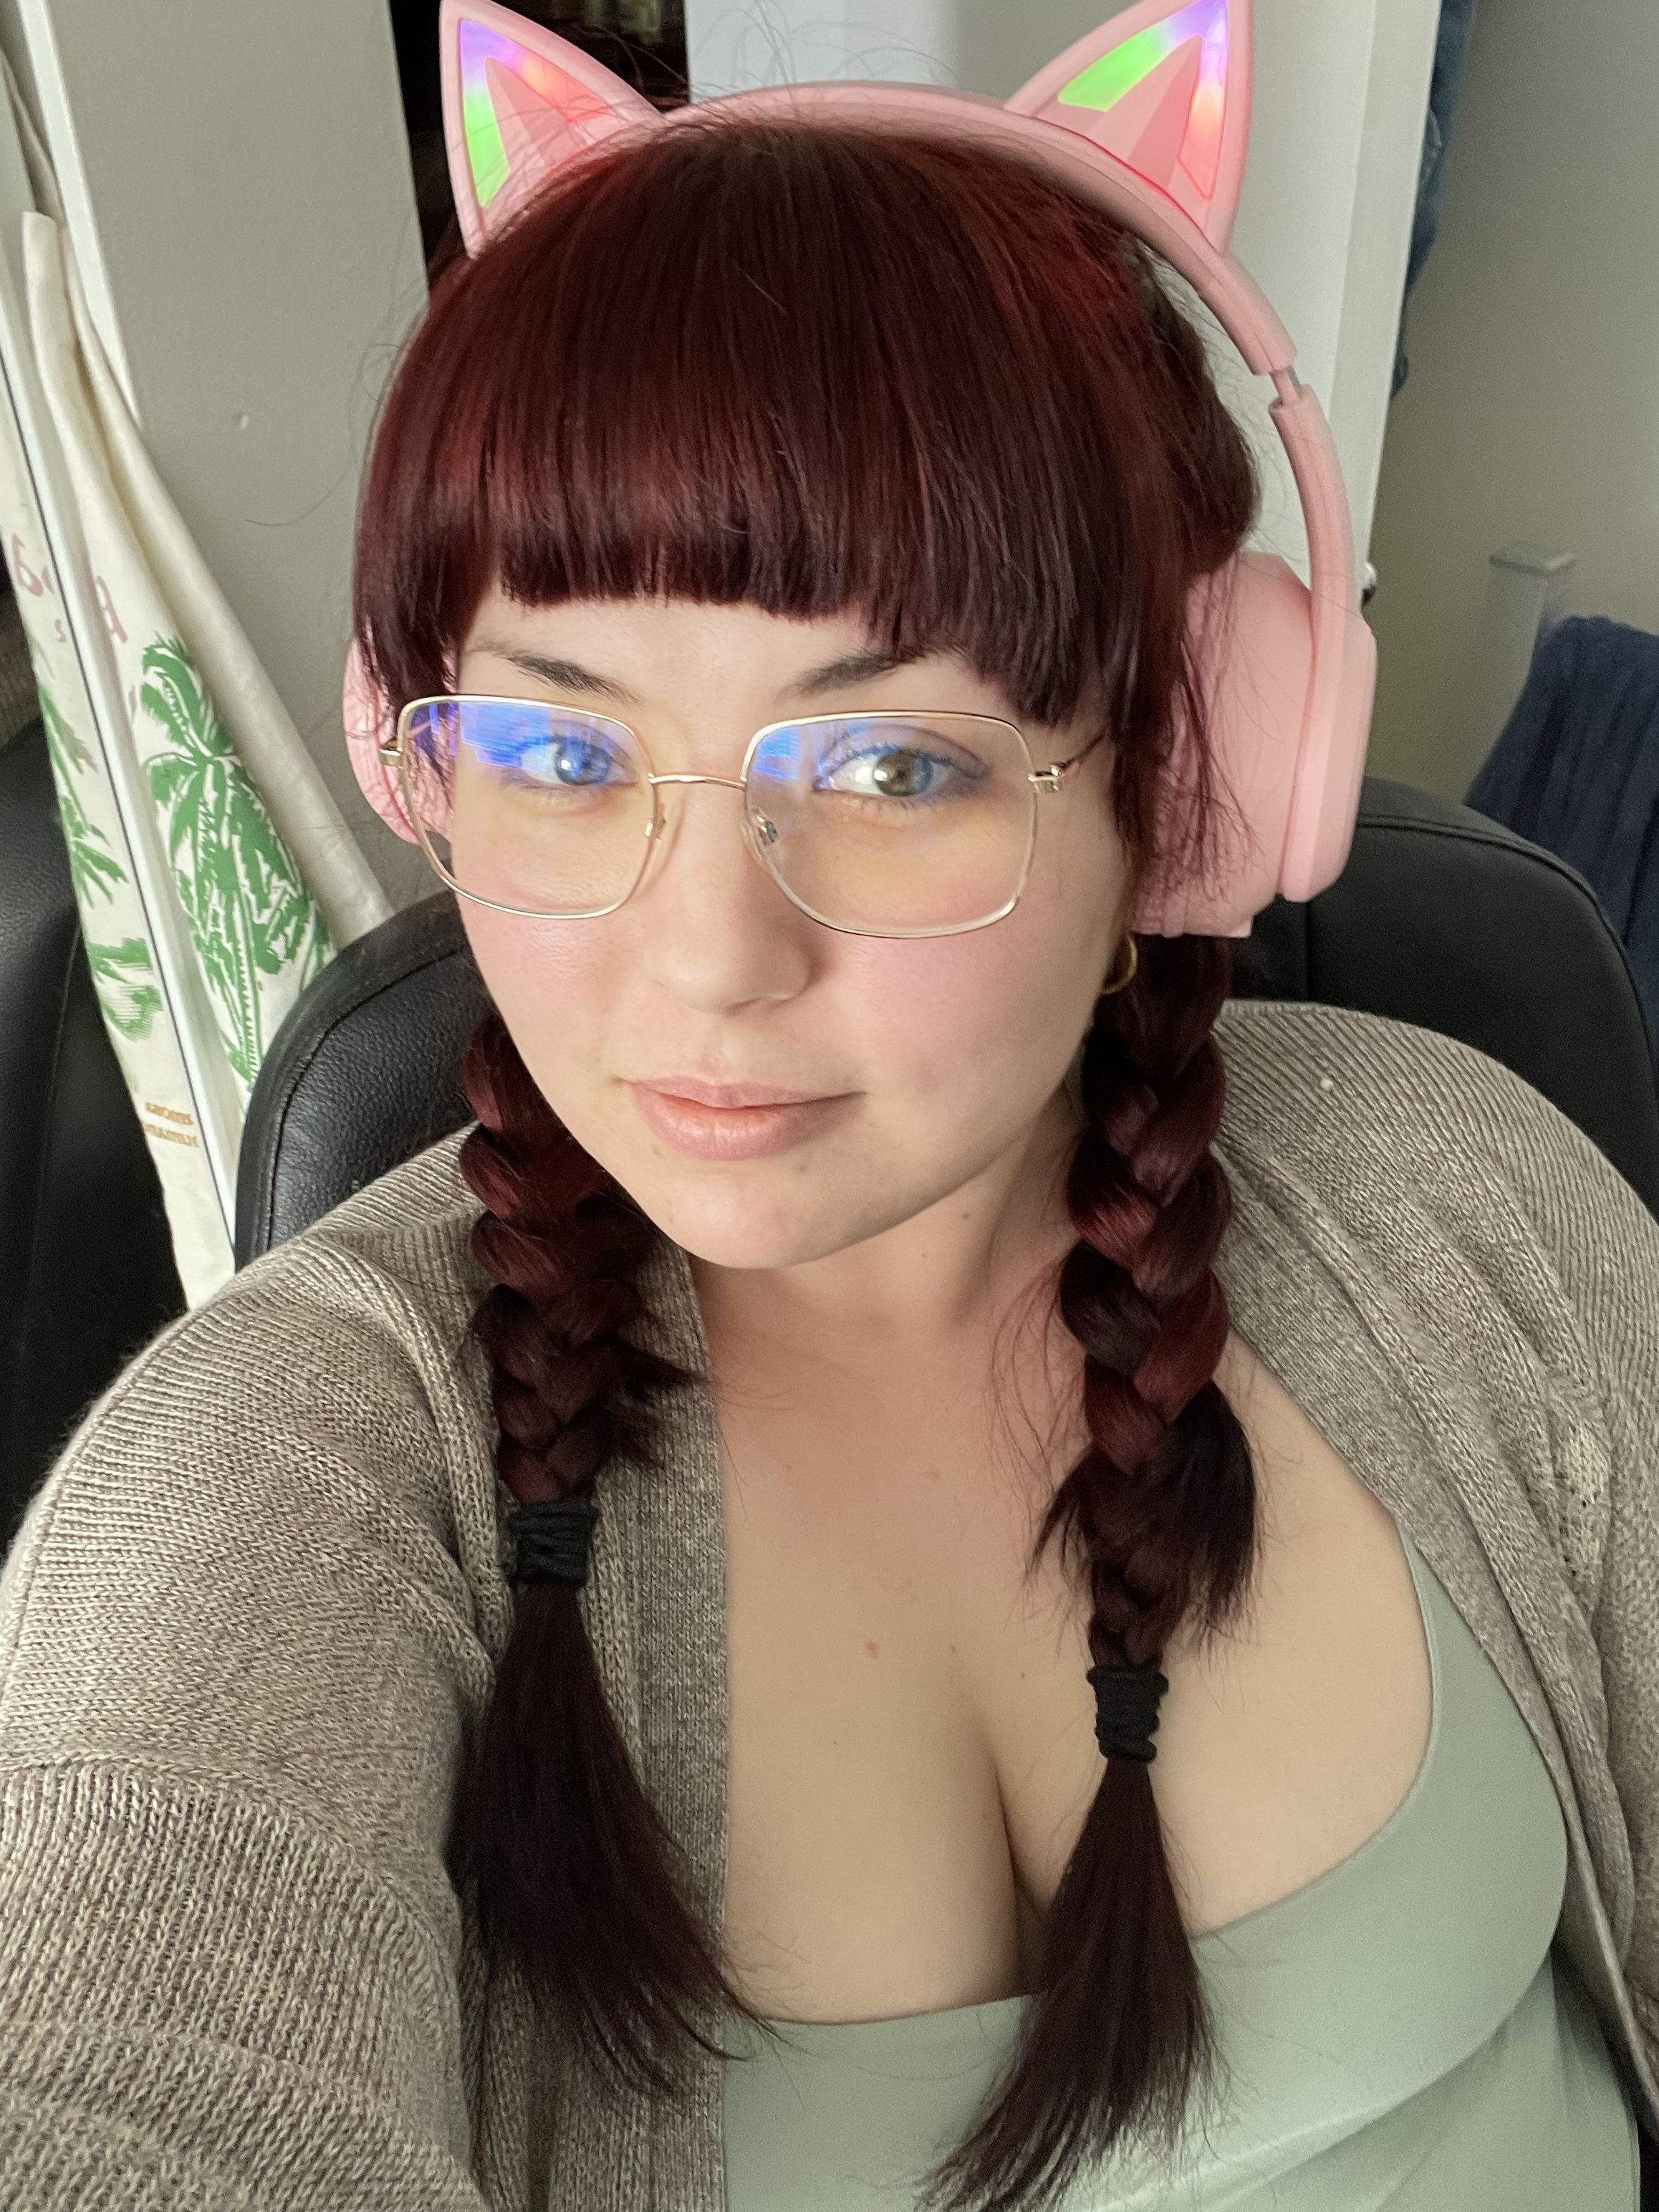
FIN

